Slide 1

A Summary of: “Unpaired Image-to-Image Translation using Cycle-Consistent Adversarial Networks”
CycleGAN
Candno. 183708

Slide 2
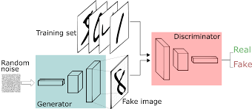
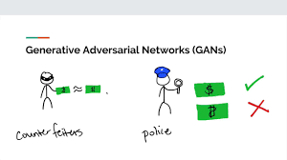
GANs – Generative Adversarial Networks
Two neural networks:
The Generator
The Discriminator
Image 1
Applications of a GAN:
Video Gaming
Science
Art
Image 2

Slide 3
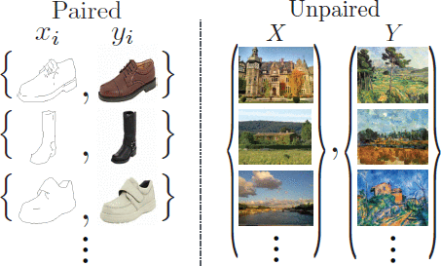
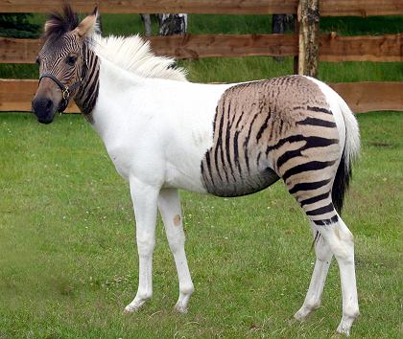
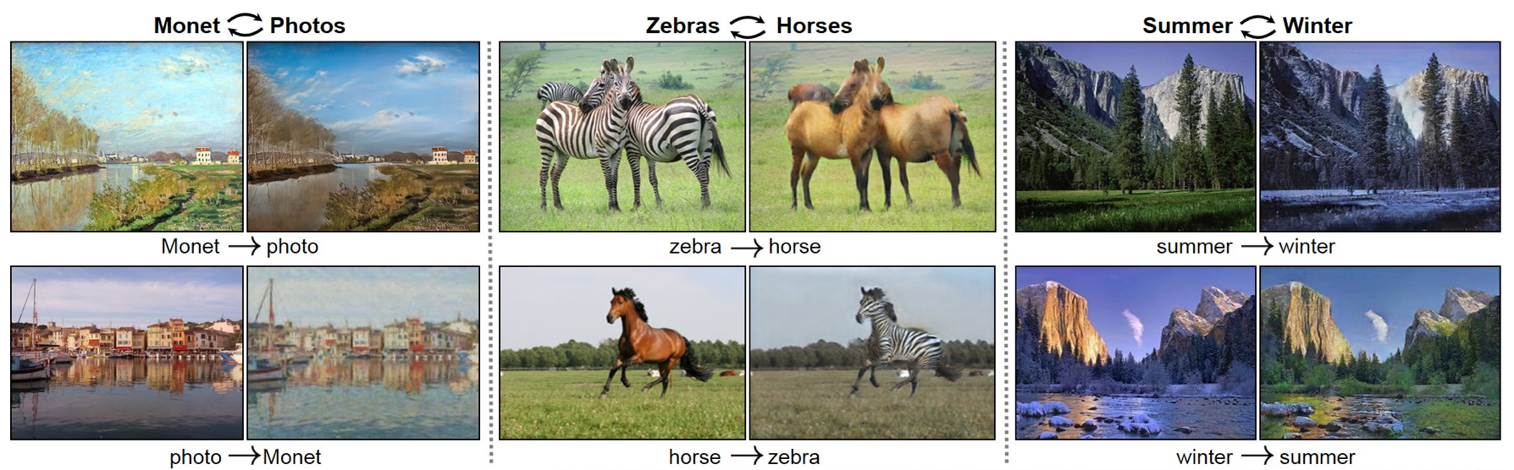
CycleGAN – Unique Image to Image Translation
Paired image data can be unrealistic and without input from the artist it becomes near impossible.
In many object transfigurations the required output may not even be well defined.
Image 3
Image 4
An assumption of some form of relationship between the two domains is essential for mapping.
Image 5

Slide 4
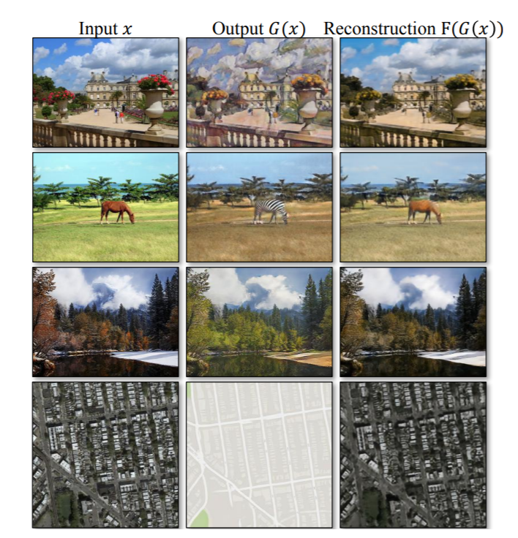
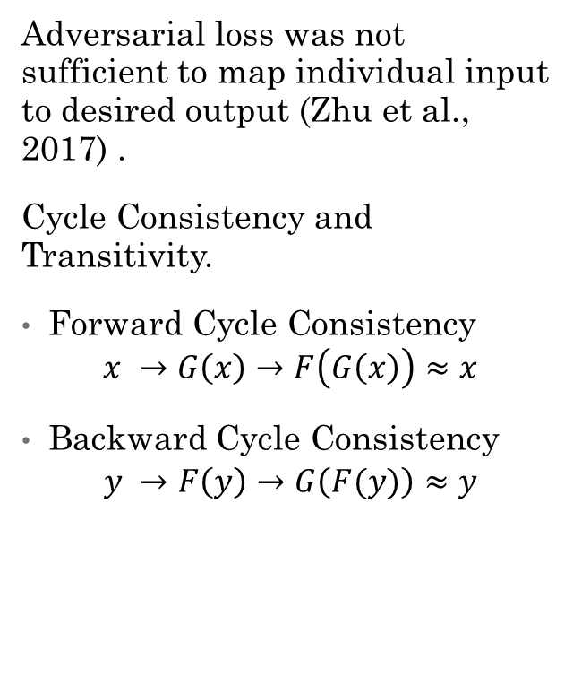
Cycle Consistency and Cycle Consistency Loss
Adversarial loss was not sufficient to map individual input to desired output (Zhu et al., 2017) .
Cycle Consistency and Transitivity.
Forward Cycle Consistency
$$x →G\left(x\right)→F\left(G\left(x\right)\right)≈x$$
Backward Cycle Consistency
$$y →F\left(y\right)→G\left(F(y)\right)≈y$$
Image 6

Slide 5
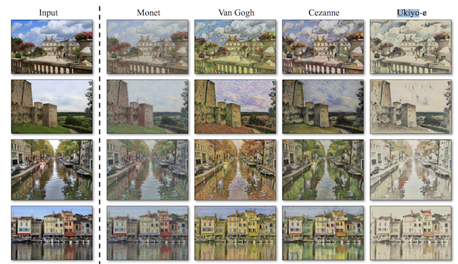
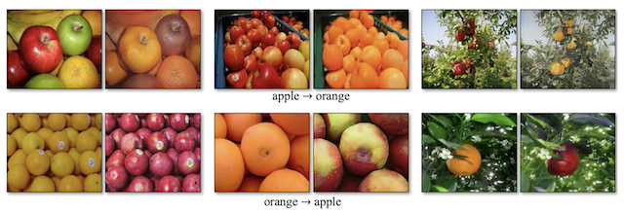
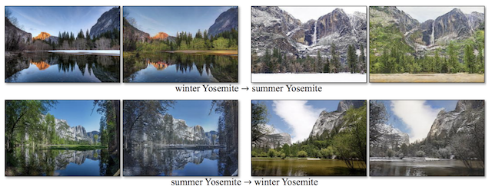
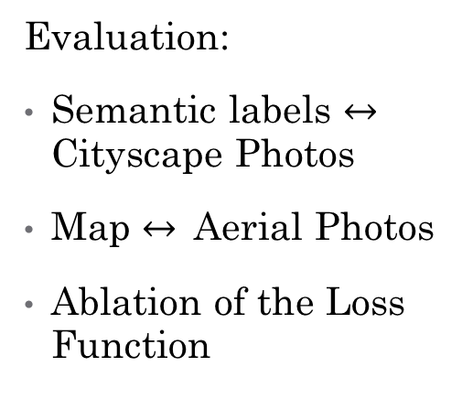
Results and Applications
Style Transfer
Evaluation:
Semantic labels $↔$ Cityscape Photos
Map $↔$ Aerial Photos
Ablation of the Loss Function
Image 7
Object Transfer
Image 8
Season Transfer
Image 9

Slide 6
References
Original Paper: J. Zhu, T. Park, P. Isola and A. A. Efros, "Unpaired Image-to-Image Translation Using Cycle-Consistent Adversarial Networks," 2017 IEEE International Conference on Computer Vision (ICCV), Venice, 2017, pp. 2242-2251, doi: 10.1109/ICCV.2017.244.
A. Hertzmann, C. E. Jacobs, N. Oliver, B. Curless, and D. H. Salesin. Image analogies. In SIGGRAPH, 2001.
Images in Numerical Order:
https://pathmind.com/wiki/generative-adversarial-network-gan
https://i.ytimg.com/vi/ZRgwcMqxhPw/maxresdefault.jpg
https://ieeexplore.ieee.org/mediastore_new/IEEE/content/media/8234942/8237262/8237506/8237506-fig-2-source-large.gif
https://www.wired.com/images_blogs/photos/uncategorized/2007/07/05/0102090491400.jpg
https://ieeexplore.ieee.org/mediastore_new/IEEE/content/media/8234942/8237262/8237506/8237506-fig-1-source-large.gif
https://arxiv.org/pdf/1703.10593.pdf

Slide 7
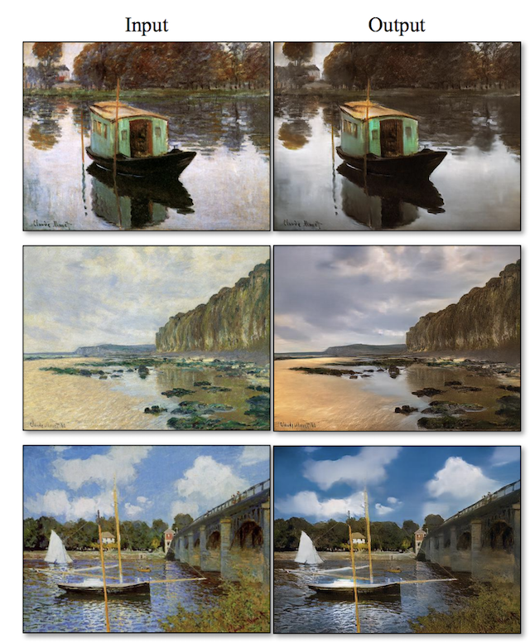
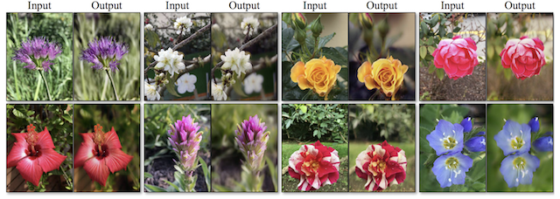
Further Transfer Examples
Photograph Generations from Paintings
Photograph Enhancements
Image 11
Image 10

